Slide 1
<Simulink Block> Documentation
Common Simulation Architecture (CSA)
<Submission Date>
<Your Name>
<Your Title>

Slide 2
Contents
These charts document the Common Simulation Architecture’s Simulink Block <Simulink Block>
Block Path: <Enter Relative Path to block in CSA_Library>
Acronyms and Documentation Formatting
Block Overview
Verification Folder Details
Reference Data
Validate & Test Results

Slide 3
Acronyms and Documentation Formatting
Documentation formatting
MATLAB Scripts / Functions - bold
MATLAB Workspace Variables - Courier New Font
Simulink Subsystem Blocks - Italic
External Documents - Underline
Acronyms shall be clearly defined
Acronym | Description
CM | Configuration Management
CoP | Community of Practice
CoSMO | Common Simulation Modeling Object
CoSMO’d | Act of creating a CoSMO and all associated documentation
CSA | Common Simulation Architecture
GNC | Guidance, Navigation, & Control
I/O | Input / Output
RTCF | Real-Time Component Framework
NGC | Northrop Grumman Corporation

Slide 4
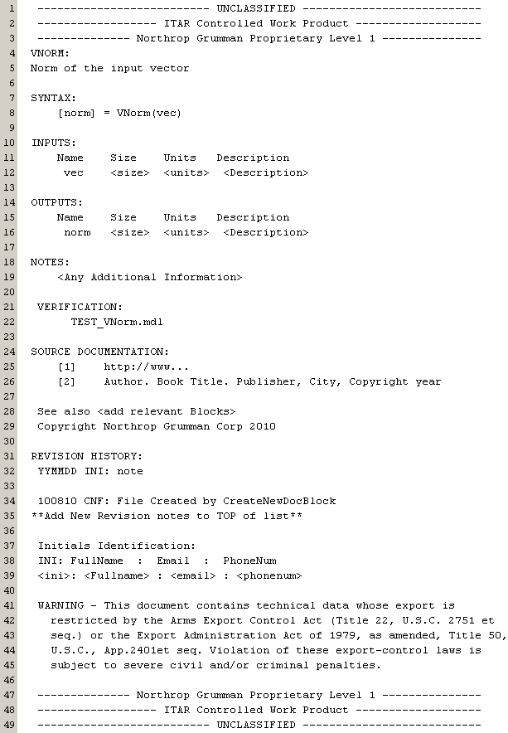
<Simulink Block> Overview
Insert Screen Shot of Block’s help as it exists in the Doc block within the component

Slide 5
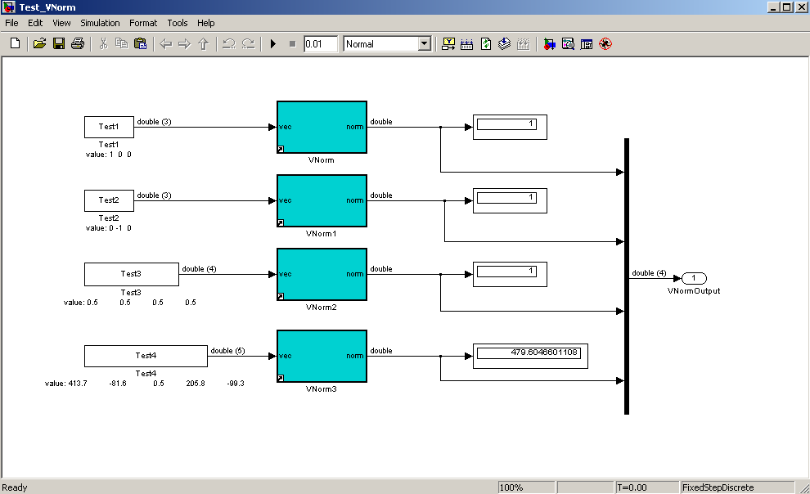
TEST_<Simulink Block> Overview
Insert Screen Shot of Unit Test for the Block with port dimensions and data type
Use ViewValues in TEST_<Simulink Block>.mdl Model Callbacks
ModelProperties > Callbacks > InitFcn > if(exist('ViewValues')) ViewValues(1); end

Slide 6
<Simulink Block> Verification Folder Details
Filename | Description
<Simulink block path> | The block itself with appropriate internal documentation
Test_<Block Name>.mdl | Script or function that links to the library block can execute a sufficient number of tests for verification
Driver_<Block Name>.m | Script or function that (if needed) exercises (e.g. test drives) the block with different test inputs compiles the results into tables or figures exports those results to a stand-alone file format (e.g. PowerPoint or Word)
<Block Name> Documentation.x (.ppt, .doc, .txt, .rtf, etc.) | Main documentation for component (e.g. This Document). Contains information on: Description and Intended Use Source References and Data Inputs and Outputs Model Dependencies Test Procedures and Results
Components_SourceData.x (.xls, .csv, .txt, etc.) | Function’s raw, unaltered, unformatted source data
Build_ComponentData.m | Support script that reads in source data, formats it, and produces a single MATLAB workspace variable or structure saved as a .mat file
ComponentData.mat | Output of Build_ComponentData.m
Plot_ComponentData.m | Support script that plots the data within the .mat file, ensuring that the source data has been read in and formatted correctly
Required for all blocks
For more complex blocks, include ALL source data files, build files, resultant .mat files, plotting routines

Slide 7
<Simulink Block> Reference Data
List Reference Files and Programs (if applicable)
Cite Excel tables, CSV files, textbooks
Document equations used
Use ‘Microsoft Equation’ if applicable
Document initialization / build-up script
Did data need to be loaded from an Excel or text file?
What workspace variables were created?
What does that structure look like?

Slide 8
<Simulink Block> Validation & Test Results
Name of Validation Script(s):
Validation Check #1
Test Input
Expected Output
Validation Check #2
Test Input
Expected Output
Things to Consider
How could a user break this block (intentionally or unintentionally)?
Is there input/output error checking? Is there divide by zero protection?
Can the block be called with empty variables or strings (e.g. [ ] or ‘ ‘)?
Is it code generatable?
Insert as many slides as necessary with screen shots, plots, tables, etc. that prove that this function works as intended
The function’s complexity will dictate the amount of testing required.

